Slide 1

Suffolk County Music Service Presents:
Ode to
Joy
Composed by Ludwig van Beethoven
(arranged by Lucy Pankhurst and adapted from Puzzle Pieces)

Slide 2

Let’s Perform!
Let’s learn the structure for the whole song and then perform all together!
Introduction
Section A
Section B
Section C
Ending

Slide 3

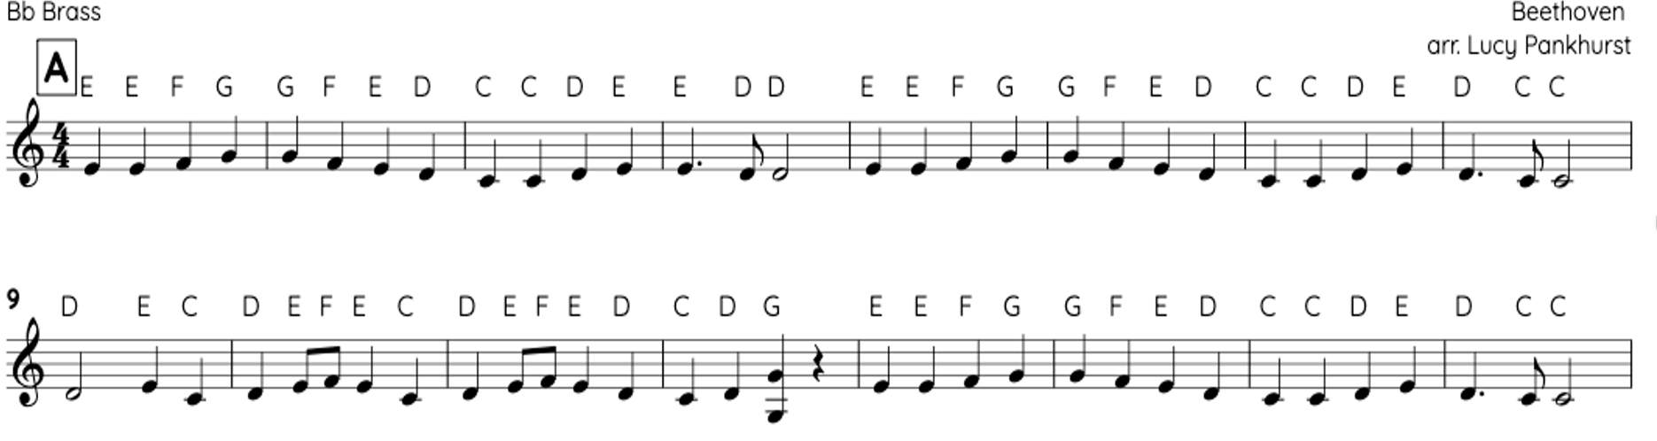
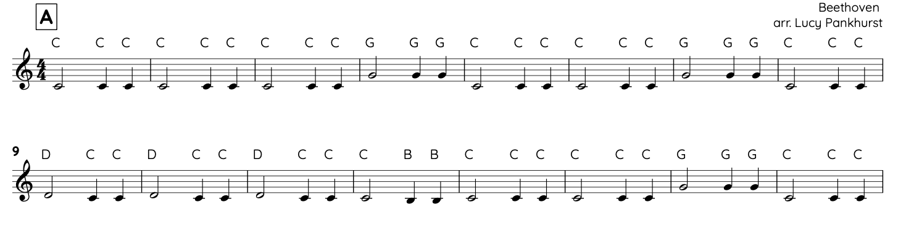
Section A
OR

Slide 4

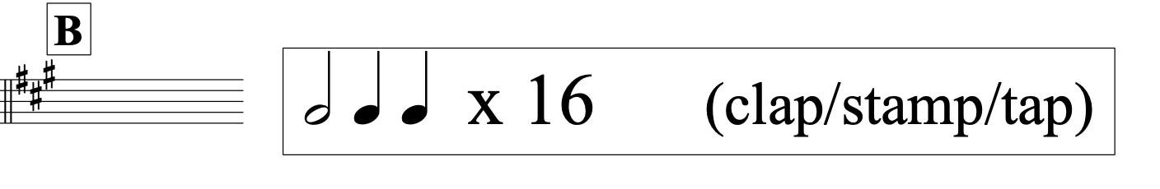

Slide 5
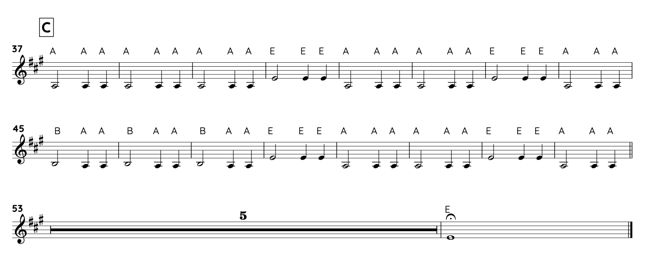
Section C

