Slide 1

I’m a Believer
BAND INTRO
GET READY TO PLAY!
Slow speed

Slide 2
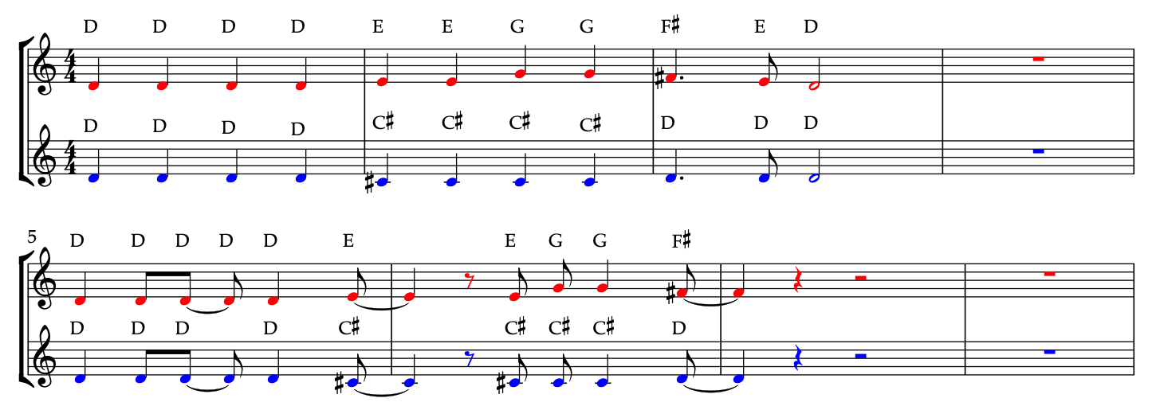
Verse 1 (SLIDE 1)

Slide 3
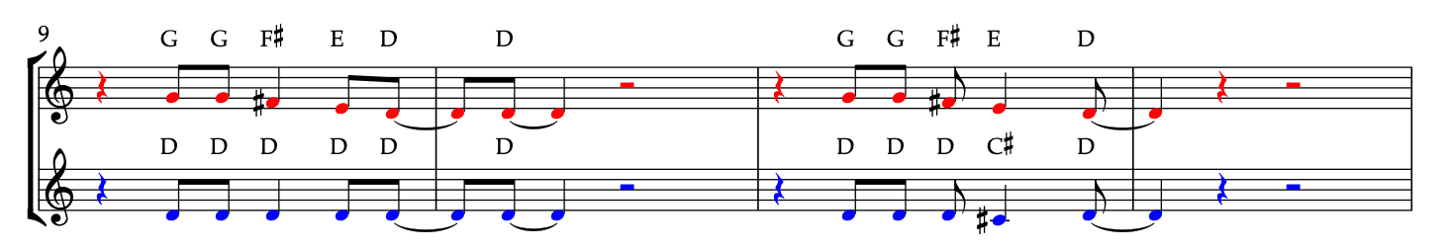
Verse 1 (SLIDE 2)

Slide 4
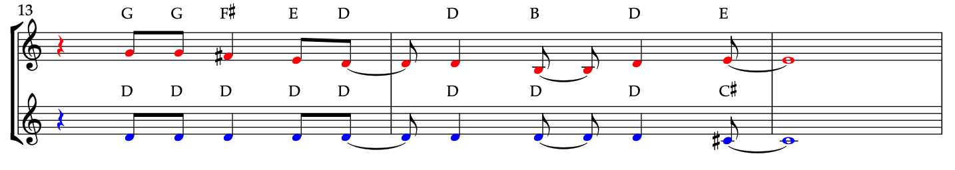
Verse 1 (SLIDE 3)

Slide 5
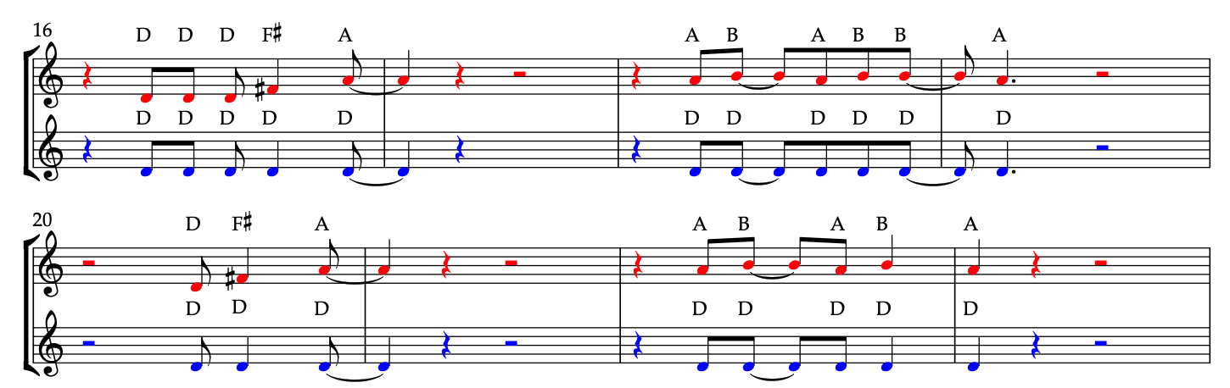
Chorus 1 (slide 1)

Slide 6
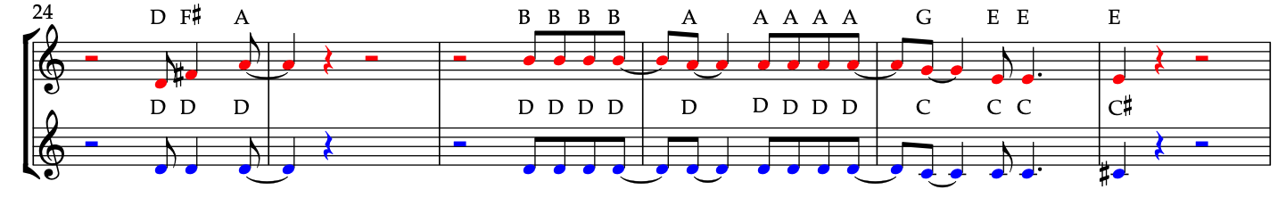
Chorus 1 (slide 3)

Slide 7
BAND break
GET READY TO SING!

Slide 8
Verse 2 (SING)
I thought love was only true in fairytales,
*stamp, stamp, stamp, OI!*
Meant for someone else but not for me,
Love was out to get me,
That’s the way it seemed,
Disappointment haunted all my dreams…

Slide 9
Chorus 2 (SING)
Then I saw her face,
Now I’m a believer!
Not a trace,
Of doubt in my mind,
I’m in love…
I’m a believer, I couldn’t leave her if I tried

Slide 10
BAND BREAK
GET READY TO PLAY!

Slide 11
Verse 3 (SLIDE 1)

Slide 12
Verse 3 (SLIDE 2)

Slide 13
Verse 3 (SLIDE 3)

Slide 14
Chorus 3 (slide 1)

Slide 15
Chorus 3 (slide 2)

Slide 16
FINAL Chorus (SING WITH HARMONY)
Then I saw her face,
Now I’m a believer!
Not a trace,
Of doubt in my mind,
I’m in love…
I’m a believer, I couldn’t leave her if I tried

Slide 17
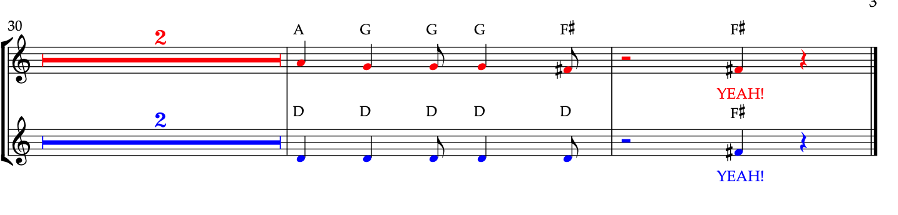
BAND BREAK
GET READY TO PLAY LAST 5 NOTES!

